Slide 1


developed by: Lucky Dog Analytics Noelle Matthews & Travis Mckenzie
Wide World Importers
W
Notes:
Intro- Noelle
Hi everyone — thanks so much for being here. I’m Noelle Matthews, and this is Travis McKenzie. Together we’re Lucky Dog Analytics. Over the last several weeks, we’ve worked closely with your data, systems, and goals to create a solution we believe will significantly reduce inventory-related costs, streamline operations, and help WWI scale. We’re excited to walk you through what we found and what’s possible moving forward.

Slide 2
agenda
Missed Sales Opportunities
Holding Costs & Overstock
Hidden Prices
The Solution
Architecture Diagram
Proof of Concept
Wins & ROI
Conclusion & Next Steps
Notes:
Agenda - Travis
Here’s a quick look at what we’ll cover today, we’ll start with some of the challenges WWI’s been facing, walk through our proposed solution and architecture, share our proof of concept highlights, and end with projected wins and implementation next steps.

Slide 3

Out of stock: a lost sale
A high-demand item sells out in days
A key retail customer calls to place a large reorder
No warning system, no backup stock
The customer goes elsewhere
Notes:
Story - Noelle
One of WWI’s most loyal clients placed a big reorder, but by the time they called, inventory had already run out. There was no low-stock alert, no backup strategy. That client couldn’t wait , so they went to another supplier. And in wholesale, that’s more than just one lost sale; it’s a broken relationship.

Slide 4

Surrounded: Excess stock
Over-ordered items sit unsold in the warehouse for months
Capital is tied up, cash flow suffers
Space issues slow down fulfillment
Notes:
Travis -
WWI’s had several items that were historical hot sellers — but demands shifted Months later, thousands of units remain unsold, tying up capital and crowding warehouse space.
This is what happens when demand projections miss the mark: You're not just holding unsold product — you're losing opportunities to stock faster-moving, more profitable items.

Slide 5
Hidden inventory costs
Customer Impact
Financial Impact
What’s Driving the Problem?
2,100 backorders annually
17-day average fulfillment delay
41% of customer complaints = inventory-related
Legacy WMS
Manual demand forecasting in Excel
No automated inventory control
Manual processing and oversight
$2.1M annual cost of mismanagement
$850K in lost sales
$425K in additional labor
$375K in expediated shipping
$450K in write-offs
Notes:
Noelle -
These aren’t abstract numbers. They represent real friction for WWI’s customers, real costs to the business, and real barriers to growth.
A full third of orders experience backorders. Nearly 1 in 5 invoices need manual correction. And it’s costing WWI over $2 million every year, not counting reputational damage.
Much of this can be traced to outdated systems and a lack of predictive insight. We believe this is exactly where a modern, data-driven inventory solution can make a measurable impact.
These numbers aren’t just stats; they represent real customer pain and real cost. Over 2,000 backorders a year, fulfillment delays of more than two weeks, and $2.1 million in annual losses tied directly to inventory issues. The root cause? Manual forecasting, outdated systems, and a lack of automation.

Slide 6
SOLUTION: End-to-end inventory optimization with Microsoft fabric, Lucky Dog & power bi
Customer & Sales Activity
Data Loaded - MS Fabric Lakehouse
Data from ERP, CRM & suppliers is extracted via Azure Data Factory
Data Transformed
ERP captures sales, returns and inventory impact
Stored in Raw Data Layer
Structured into Aggregated Layer for modeling
Predictive Models & Analytics
Dashboards
Demand Forecasting
Stock Optimization
Supplier Performance
Forecasts - Power BI
Semantic model enables dashboards, visualizations & alerts
Alerts & Reports
On-Demand access to trends, risks & recommendations
CRM collects feedback & preferences
Cleaned & standardized
Power BI & Power Automate send email alerts for stock issues
Dynamic manager engagement
Continuous Learning
Notes:
Travis -
What we are providing isn’t just a dashboard. It’s a full data-to-decision solution.
This system predicts demand, monitors performance, and drives real-time decisions.
Data is generated, extracted, loaded and transformed. From there, we integrate advanced demand forecasting, stock optimization, supplier performance and much more.
Alerts, reports and dashboards engage and inform decision makers.
This enables WWI to reduce overstocking, eliminate costly backorders, and make inventory operation smarter, faster, and scalable.

Slide 7
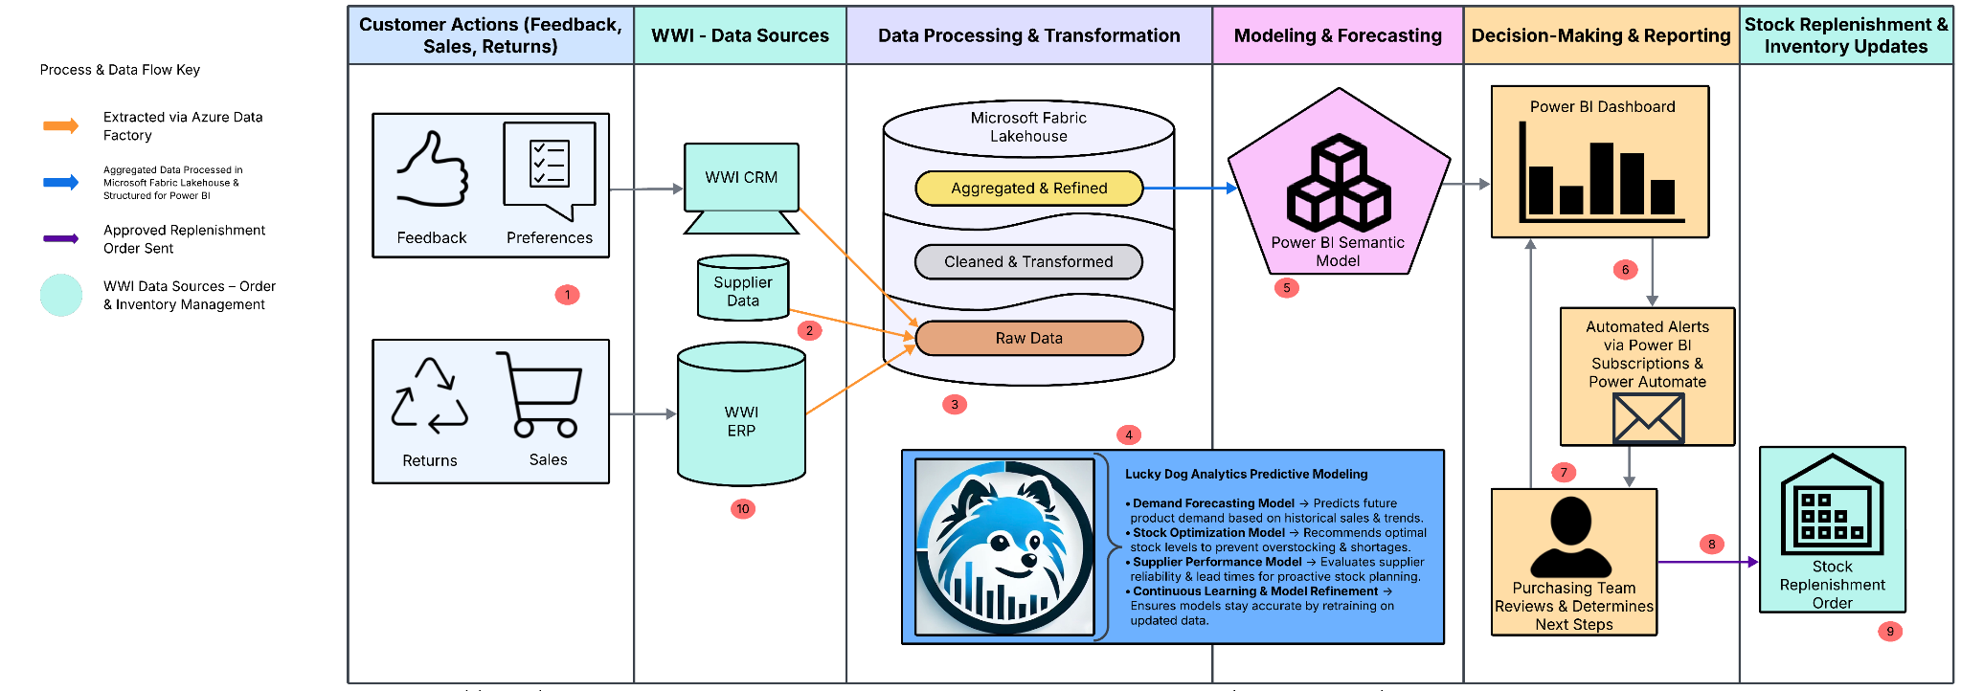
Notes:
Noelle:
Our architecture starts by capturing customer feedback, order history, and supplier data — all pulled from WWI’s CRM, ERP, and vendor systems.
That data flows into Microsoft Fabric using Azure Data Factory, where it’s cleaned, standardized, and transformed through a multi-layered lakehouse structure.
From there, we apply predictive models for demand forecasting, stock optimization, and supplier performance. These models continuously learn and improve over time.
The refined insights are integrated into Power BI, where they drive real-time dashboards, automated alerts, and decision-ready reporting.
When a stock issue is detected, managers are notified instantly and can review forecasts, assess risks, and approve replenishment — all directly from the dashboard.
Once an order is approved, it flows back into WWI’s ERP system, updating inventory and completing the loop.
Other option:
Let me break this down quickly- Data is pulled from WWI’s CRM, ERP, and supplier systems into a centralized lakehouse. It’s cleaned, transformed, and modeled to feed predictive insights. We’ve built models for demand forecasting, stock optimization, and supplier performance — all accessible through Power BI. Alerts and dashboards surface critical issues instantly, so purchasing teams can replenish stock before problems occur. And the entire loop feeds back into your ERP, ensuring inventory data stays current and actionable.

Slide 8

Notes:
Travis
Power bi
Here’s one of the dashboards we built as part of the proof of concept. You can instantly spot trends — what’s moving, what’s stuck, and where you’re headed. It’s clean, real-time, and filterable by product category, lead time, stock on hand, order forecasts and reorder alerts.

Slide 9
Notes:
Here we see another view which allows decision makers to review a running sum of sales. We can easily see how all stock items historically have performed, assess those items’ performance and ensure that our stock levels are aligned with trends and expectations.

Slide 10
What WWI Gains: Operational Benefits
Reduced Stockouts & Backorders
Improved Forecast Accuracy
Shorter Delays, Fewer Cancellations
Real-Time Alerts & Automated Reports
Streamlined Replenishment
Supplier Performance Visibility
Notes:
Noelle:
Operationally, WWI gains speed, visibility, and confidence. You’ll reduce backorders, spot disruptions early, and make decisions based on data, not guesswork. It’s about fewer surprises and more control.
Or
Operationally, this gives WWI speed, accuracy, and control. You’ll be able to make data-backed inventory decisions quickly, reduce delays, and improve trust across your supply chain.

Slide 11
Strategic Wins & system-level value
Fewer Write-Offs & Expedited Shipping
Scalable Data Architecture (Microsoft Fabric)
Power BI for Full-Company Visibility
Improved Cross-Team Collaboration
Forecasts Improve Over Time
Foundation for Future Growth
Notes:
Travis
From a strategic lens, this architecture sets you up for long-term value. It scales, it learns, and it brings your teams from supply chain to finance- onto the same page.
Strategically, this solution creates long-term value. You’re not just solving today’s problems, you’re setting up the infrastructure to support future growth, new use cases, and a more aligned organization.

Slide 12
Immediate impacts
Cost Area | Previous Cost | Projected Savings
Lost Sales | $850,000 | ↓ by up to 60%
Write-Offs | $450,000 | ↓ by up to 40%
Expedited Shipping | $375,000 | ↓ by up to 50%
Labor Costs | $425,000 | ↓ by up to 30%
Admin Error Adjustments | High | ↓ from 18% to under 5%
Total Potential Impact | $2.1M | ~$1.2M in annual savings
Notes:
Noelle:
These numbers tell a compelling story. Just by addressing the core issues in inventory mismanagement, WWI could potentially recoup over $1.2 million annually. Reducing lost sales and write-offs is the most obvious win, but don’t overlook the softer savings, like minimizing admin errors and reducing labor inefficiencies. What’s especially powerful is how these gains are achievable without overhauling your entire system, we’re building on top of your existing data with smarter architecture and actionable insights.
We estimate a potential savings of over $1.2 million annually. That includes avoided losses, reduced waste, and better labor efficiency, all from more accurate forecasting and automated processes.

Slide 13
Future Enhancements & Premium Services
Scalable Add-Ons
Product lifecycle modeling
Supplier portal integrations
Churn prediction
Pricing optimization
Department-specific dashboards
Support Options
Quarterly model health checks
Dashboard refreshes
Training
Onboarding
Ecosystem Development
Notes:
We have many enhancements and premium services available.
Scalable Add-Ons include product lifecycle modeling, supplier portal integrations, churn prediction, pricing optimization and dashboard refinements.
Support Options include model health checks, dashboard refreshes, training, onboarding and ecosystem development

Slide 14



Let’s launch phase 1
Your Next Steps
Assign Internal Stakeholders
(Inventory, Ops, Finance)
Schedule Kickoff
(Target week of 5/01/25)
Confirm Milestones & Deliverables
(12-week implementation, 3 phases)
Results You’ll See
~$1.2M in Projected Annual Savings
Smarter, Faster Replenishment
Real-time Inventory Visibility
Predictive Insights for Better Decisions
Improved Collaboration Across Teams
Notes:
Noelle
We're ready to move and the system is, too! To launch Phase 1, we just need a few quick alignments: assign key internal champions, confirm a kickoff date, and finalize milestone expectations. From there, our team will take the lead on standing up the system and supporting WWI through a smooth, focused implementation. You’ll be getting measurable results within weeks; with better forecasting, smarter replenishment, and clearer cross-team visibility.

Slide 15
Thank you!
We’d love to hear your thoughts.
Lucky Dog Analytics | Noelle Matthews & Travis McKenzie
Notes:
Travis
Thank you so much for the time and attention today. We’re happy to answer any questions you have or dive deeper into any area of the solution.

